Slide 1
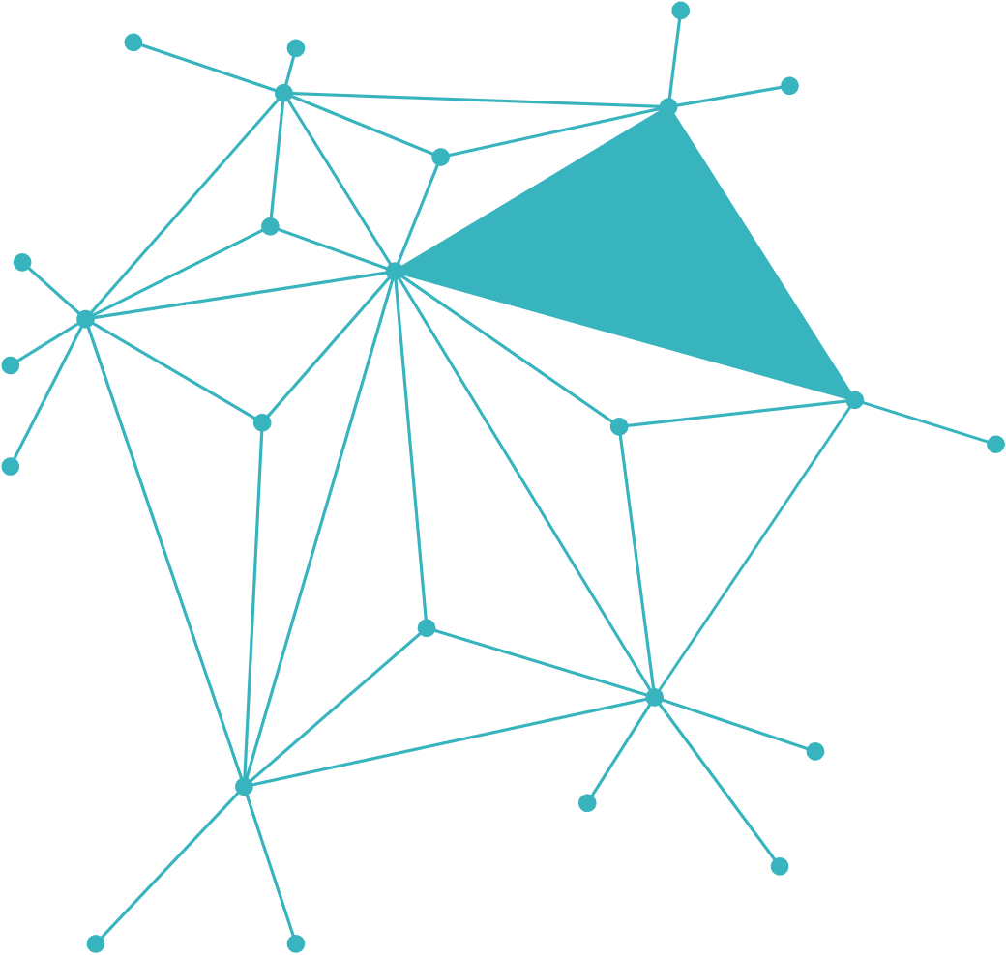

GUARDIAN_KNOT
PROJECT
Name Nimra Mumtaz
CMS ID 553839
1

Slide 2

Safety Gap:
Traditional security systems don’t check if the user is conscious or physically able to call for help.
Coercion Risk:
In forced entry or kidnapping scenarios, users are often forced to unlock their systems under threat.
Plain-Text Vulnerability:
Many basic prototypes store user data without encryption, making it easy for intruders to steal credentials.
Technical Noise:
Standard emergency logs are often too
technical and lack the emotional urgency needed for quick rescue.
2

Slide 3
User Login
Dual PIN System:
SEPARATE CODES FOR NORMAL LOGIN AND SILENT EMERGENCY.
Heartbeat Timer:
Calculate Time Gap
Uses time(0) to track user safety in real-time.
Data Privacy:
Uses Caesar Cipher encryption for all saved files.
Gap > 60s?
TRIGGER RED ALARM
Yes
Hardware Alerts:
Visual (Colors) and Auditory (Beeps) feedback.
No
SAFE ACCESS
3

Slide 4
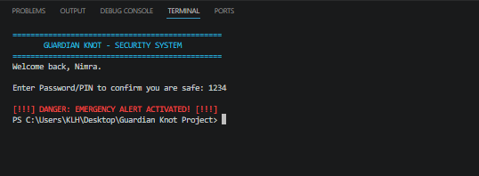
Interactive Alerts (Sound & Color)
Color Coding:
System uses Red for high-risk alerts and Green for safety confirmation (viaSetConsoleTextAttribute).
Emergency Siren:
A loud 2500Hz frequency beep is used to grab immediate attention during a timeout.
Psychological Edge:
Colors and sounds are designed to alert bystanders while keeping the user informed of the system status.
4

Slide 5
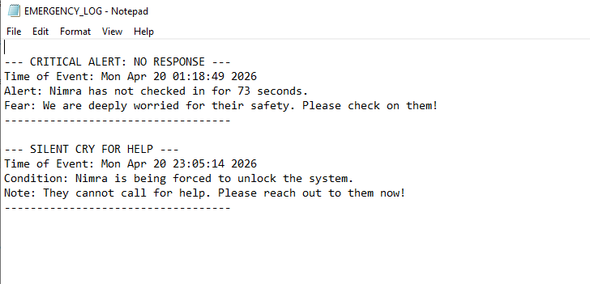
HUMAN-CENTRIC EMERGENCY LOGS
Simple Language:t
Logs are recorded in clear English for non-technical rescuers.
Silent Duress Alert:
Records a "Silent Cry for Help" in the background without alerting the intruder.
Timestamp Tracking:
Every second of the delay is logged for legal and medical review.
5

Slide 6
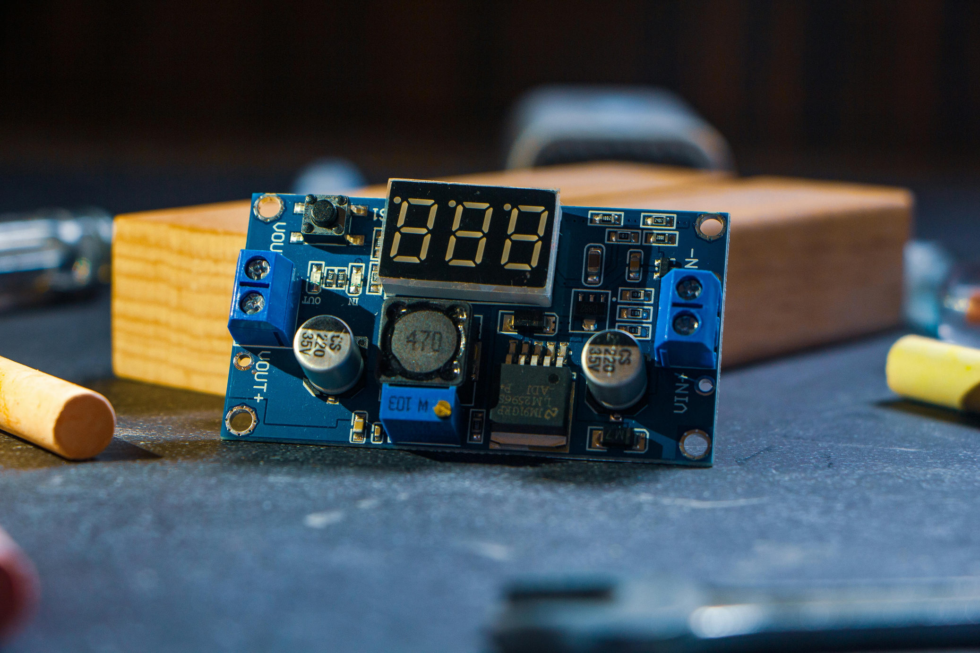
CONCLUSION & FUTURE ENHANCEMENTS
Summary:
Successfully developed a time-sensitive security system that prioritizes human safety through interval monitoring and encryption
Key Achievement:
Integrated a "Silent Duress" mode that allows users to call for help without alerting an intruder.
Future Work
Connecting the code with GSM Modules to send automated SMS alerts to local authorities.
Using Pulse Oximeter sensors to trigger alerts if the user's heart rate becomes abnormal.
Implementing a Mobile App interface for remote monitoring.
6

Slide 7
"In the silence of an emergency, every second counts. This system is the voice for the unresponsive."
Thank You!
7

